Slide 1

Car price Prediction System
Group A

Slide 2

Business Understanding
Data Understanding
Data Preparation
Modelling
table of
content
Evaluation
Deployment

Slide 3

Business Understanding
Project Domain: Automotive Secondary Market
Focused on Used Car Pricing & Valuation.
ML Relevance
Why ML? The relationship between car features (Mileage, Age, Engine Type) and Price is complex and dynamic.
It is a Supervised Regression Task (Predicting a continuous numerical value: Price).
Notes:
The first phase of the CRISP-DM methodology is Business Understanding. Our system operates in the Automotive Secondary Market—that is, the used car market.
Our core business problem is the need for reliable and fast pricing and valuation.
So, why use Machine Learning? The price of a used car isn't just a simple calculation. It’s highly non-linear
For example, the impact of high 'Mileage' is different for a luxury car versus an economy car—these are complex interaction effects that ML models, like Random Forests, are designed to capture efficiently.

Slide 4

Data Understanding
Feature Relevance
Intrinsic Value : Company Name, model name, engine capacity
Depreciation : car age, mileage
Market Factors : location, assembly, registration status, color
Collect, Describe, and Explore Data.
Identify how the car's characteristics (features) translate into its market Price (Target Variable).
Key Data Challenges
High Cardinality: Need efficient handling for variables with many unique values (e.g., model_name, location).
Categorical Data: categorical columns require encoding (e.g., One-Hot or Label Encoding).
Notes:
The core goal here is to collect our data, describe the columns we have, and begin exploring to see how the features relate to the target variable final car price
Intrinsic Value: "These features determine the base value of the car.
Depreciation: "'car_age' and 'mileage'. They are the measures of wear and tear. We need to confirm if age or mileage is the dominant factor in our dataset.
Market Factors: "These adjust the price based on local conditions.
High Cardinality: "This means features like 'model_name' and 'location' have many unique values.
Categorical Data: Everything from 'engine_type' to 'color' must be converted into a numerical format before any machine learning algorithm can process it.

Slide 5
Data Preparation
Data Cleaning (No Issues Found)
Missing Values: No null values were detected across any of the features.
Duplicates: No duplicate rows were found, ensuring unique data points.
Data Formatting (Categorical Encoding)
features that are text-based (e.g., body_type, color).
One-Hot Encoding (OHE) was applied to all categorical columns.
Feature Engineering
Problem: The model_year column is not directly useful for depreciation models.
Solution: Created a new, highly relevant feature: car_age (Current Year - Model Year).
Result: The original model_year column was deleted, simplifying the dataset while retaining critical information.
Notes:
We found zero missing values and no duplicate records,
We transformed 'model_year' into a much more valuable feature: 'car_age'—calculated as the difference between the current year and the car's model year.
We used One-Hot Encoding, or OHE. OHE transforms a single column, like 'body_type', into multiple binary columns.

Slide 6

Mix of Ridge and Lasso penalties.
Good when you want feature selection and also want to reduce overfitting.
Modelling
Problem Type: Regression
Goal: Predict a continuous numerical value (Car Price).
Machine Learning Algorithms
Linear
Regression
Random Forest
Lasso Regression
KNN Regressor
establishes a baseline performance.
Like Ridge but can remove unimportant features by setting their coefficients to zero.
Reduces variance by averaging multiple trees).
Predicts price based on similarity to other cars in the dataset.
ElasticNet
Ridge Regression
Gradient Boosting
Builds decision trees one after another, each one fixing the mistakes of the previous one.
Builds decision trees one after another, each one fixing the mistakes of the previous one.
Same as linear regression but adds a penalty to prevent overfitting.
Notes:
this is a Regression problem because we are predicting a specific number—the price—not a category."
We selected seven different algorithms, ranging from simple to highly complex, to ensure we found the absolute best fit for our data."
First, we used Linear Regression to set a baseline.
Lasso Regression :basically, it penalizes the model for being too complex, which helps prevent overfitting."
(K-Nearest Neighbors). This algorithm works on the principle of similarity. It looks at the 'K' most similar cars in the dataset and averages their prices to make a prediction."
We used Random Forest, which builds many decision trees and averages them out."
"And we used three Boosting algorithms: Gradient Boosting it work by building trees sequentially, where each new tree tries to correct the errors of the previous one. We expect our best results to come from this group."

Slide 7
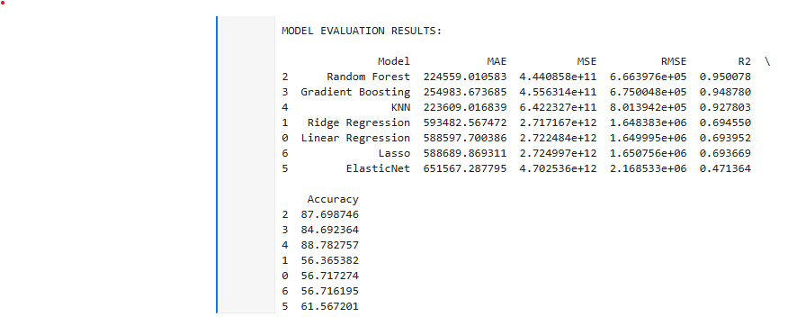
Evaluation
MAE, MSE. RMAE, R2, ACCURACY
Notes:
The Evaluation phase is where we decide which of the seven models we trained is the 'Champion.' We do this by analyzing four key performance metrics."
MAE is the most intuitive metric. If our model has an MAE of $450, it means, on average, our predicted price is $450 away from the true selling price.
RMSE is similar to MAE, but it calculates the square root of the average squared error.
R² (R-squared): "R-squared, or the Coefficient of
Determination, measures the explanatory power of our model.
An $R^2$ of 0.95, for instance, means that 95% of the reason a car sold for a specific price is captured by its features like mileage, age, and engine capacity. The closer this value is to 1, the better our features are at predicting the price.
Accuracy = 100 – MAPE
How close predictions are, in percentage
MSE measures how far your model’s predictions are from the actual values, on average

Slide 8
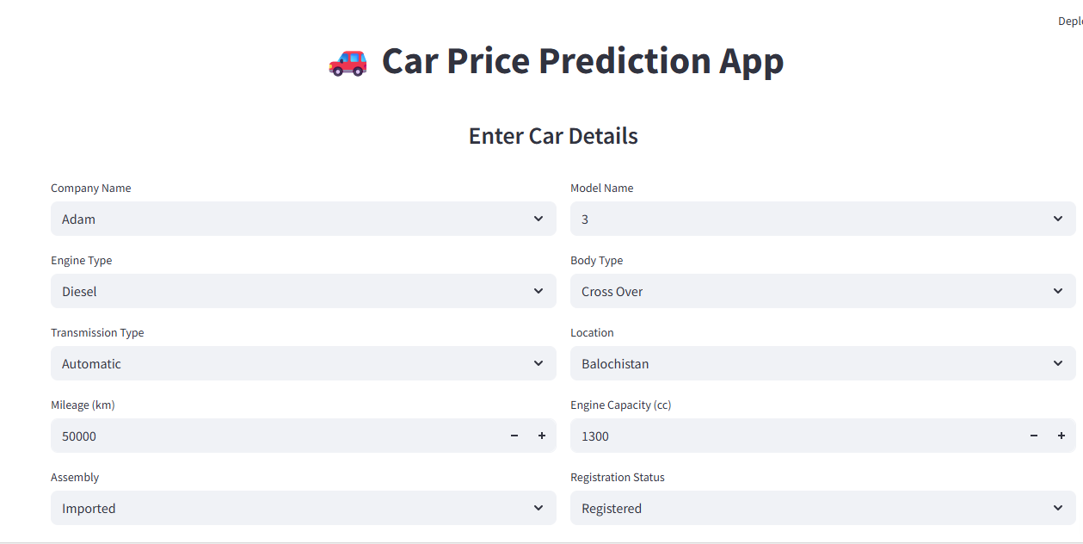
Deployment
Streamlit
Python framework that lets you turn your machine-learning code into a real, interactive web app — with almost zero web-development skills.
Notes:
Once trained, the Random Forest model was packaged into a single file—a .pkl file—which is a standard way to save a Python object."
We used Streamlit to quickly develop a user-friendly web interface. This framework allows us to build a full-featured web app using just Python."
:When a user opens the Streamlit app and inputs the car's features—the company name, mileage, engine capacity, and so on—the app loads our saved .pkl model. It then passes the input data to the model and instantly displays the predicted price."

Slide 9

conclusion
This project successfully demonstrated the end-to-end application of the CRISP-DM methodology. We began with the business challenge of subjective car pricing and delivered a highly accurate, deployed solution powered by the Random Forest Regressor.
we will use real-time user feedback from the Streamlit app to refine our data, incorporate new features, and ensure our car price predictions remain accurate and best-in-class."

Slide 10
Thank you

